Slide 1
ATP dataset from 2000-03/2018
Source: https://www.kaggle.com/datasets/edouardthomas/atp-matches-dataset
Group: Patrick Schall, Vahid Toomani
The Data source for the Kaggle data set is http://tennis-data.co.uk/

Slide 2
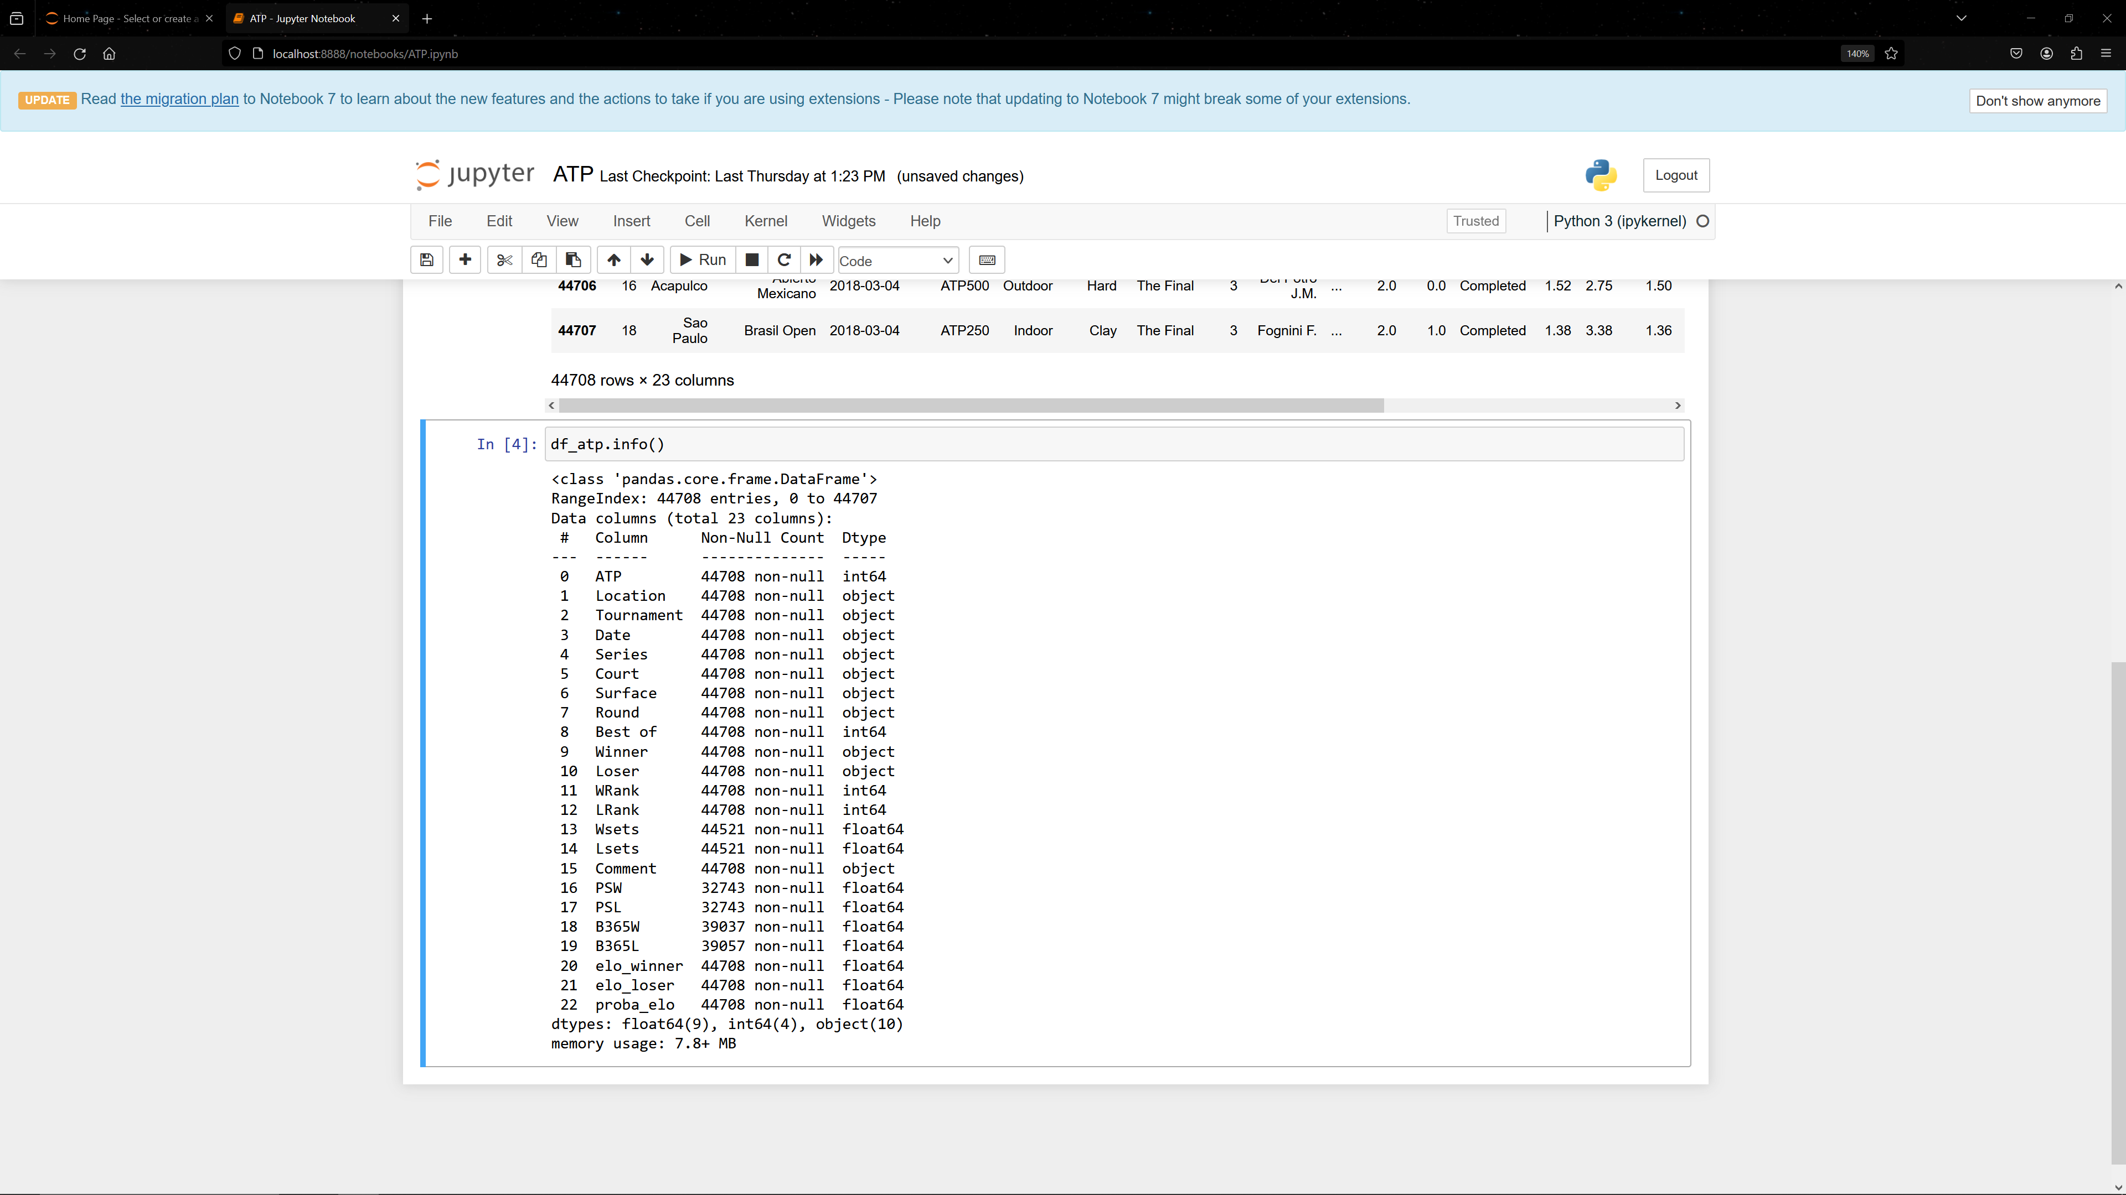
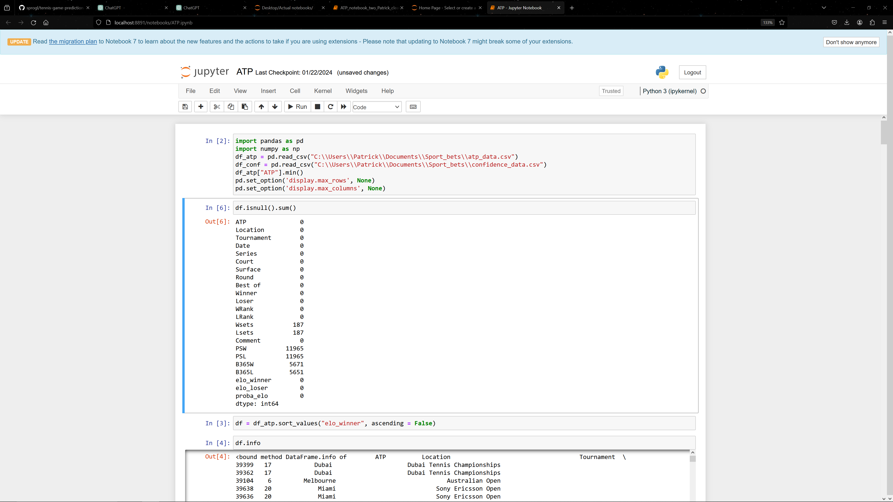
This was our first Data frame with Datapoints form 2000 till 2018
Data frame info
Data missing values

Slide 3
Missing Values
Since we had a data frame with a lot of missing values and only data till 2018 we fetched addionall data until January 2024 from http://tennis-data.co.uk/, which was also the source of the first data set.

Slide 4
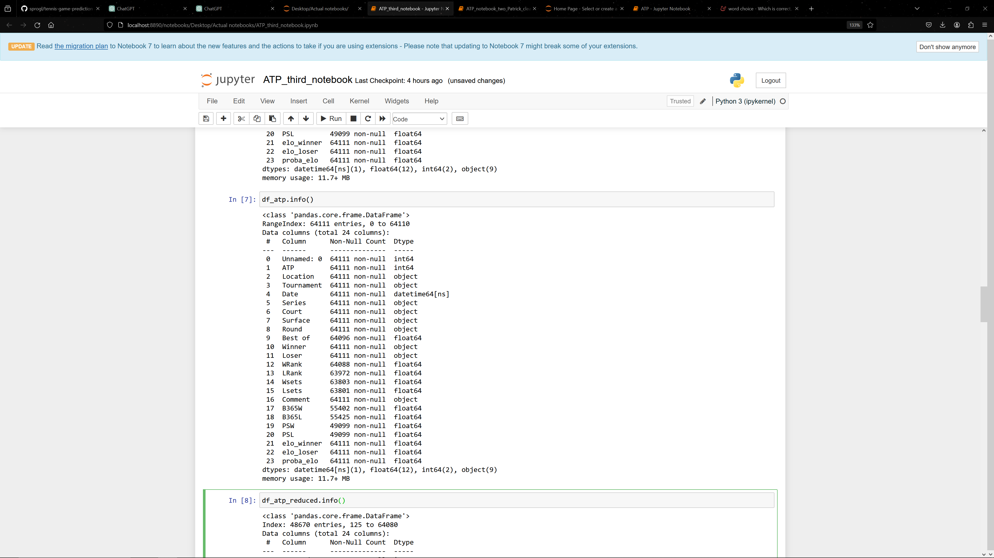
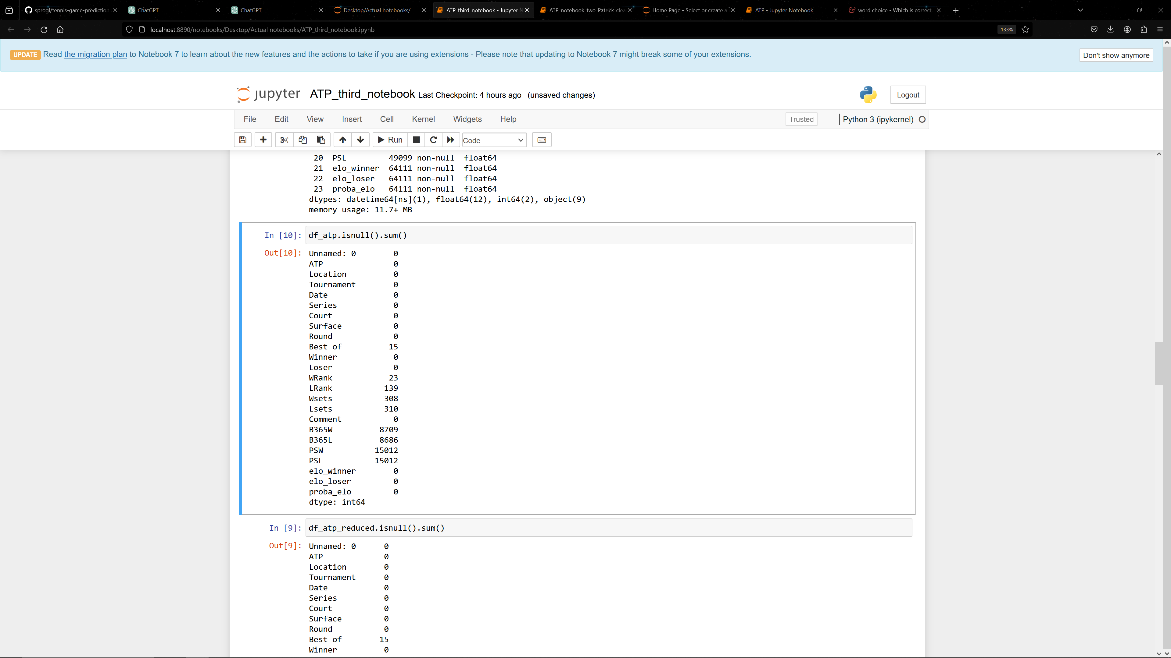
Data set with data from 2000 till 2024
new Data frame 2000-2024
new Data frame 2000-2024 missing values

Slide 5
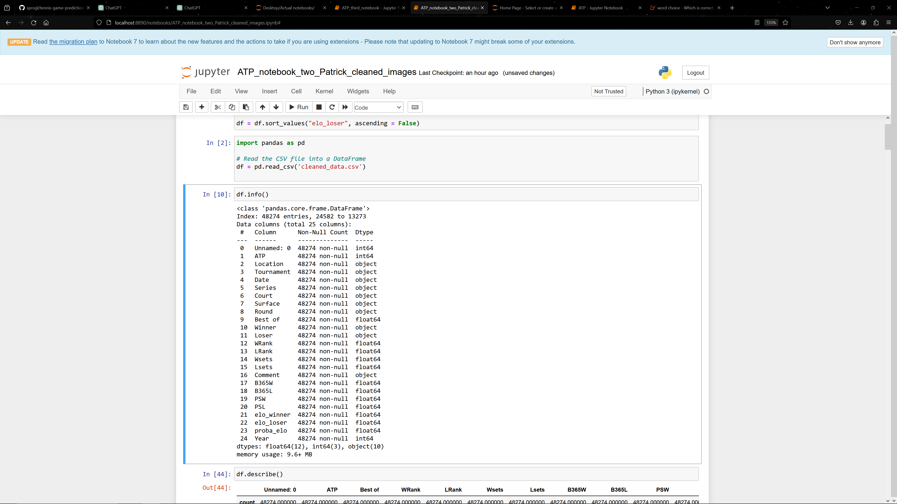
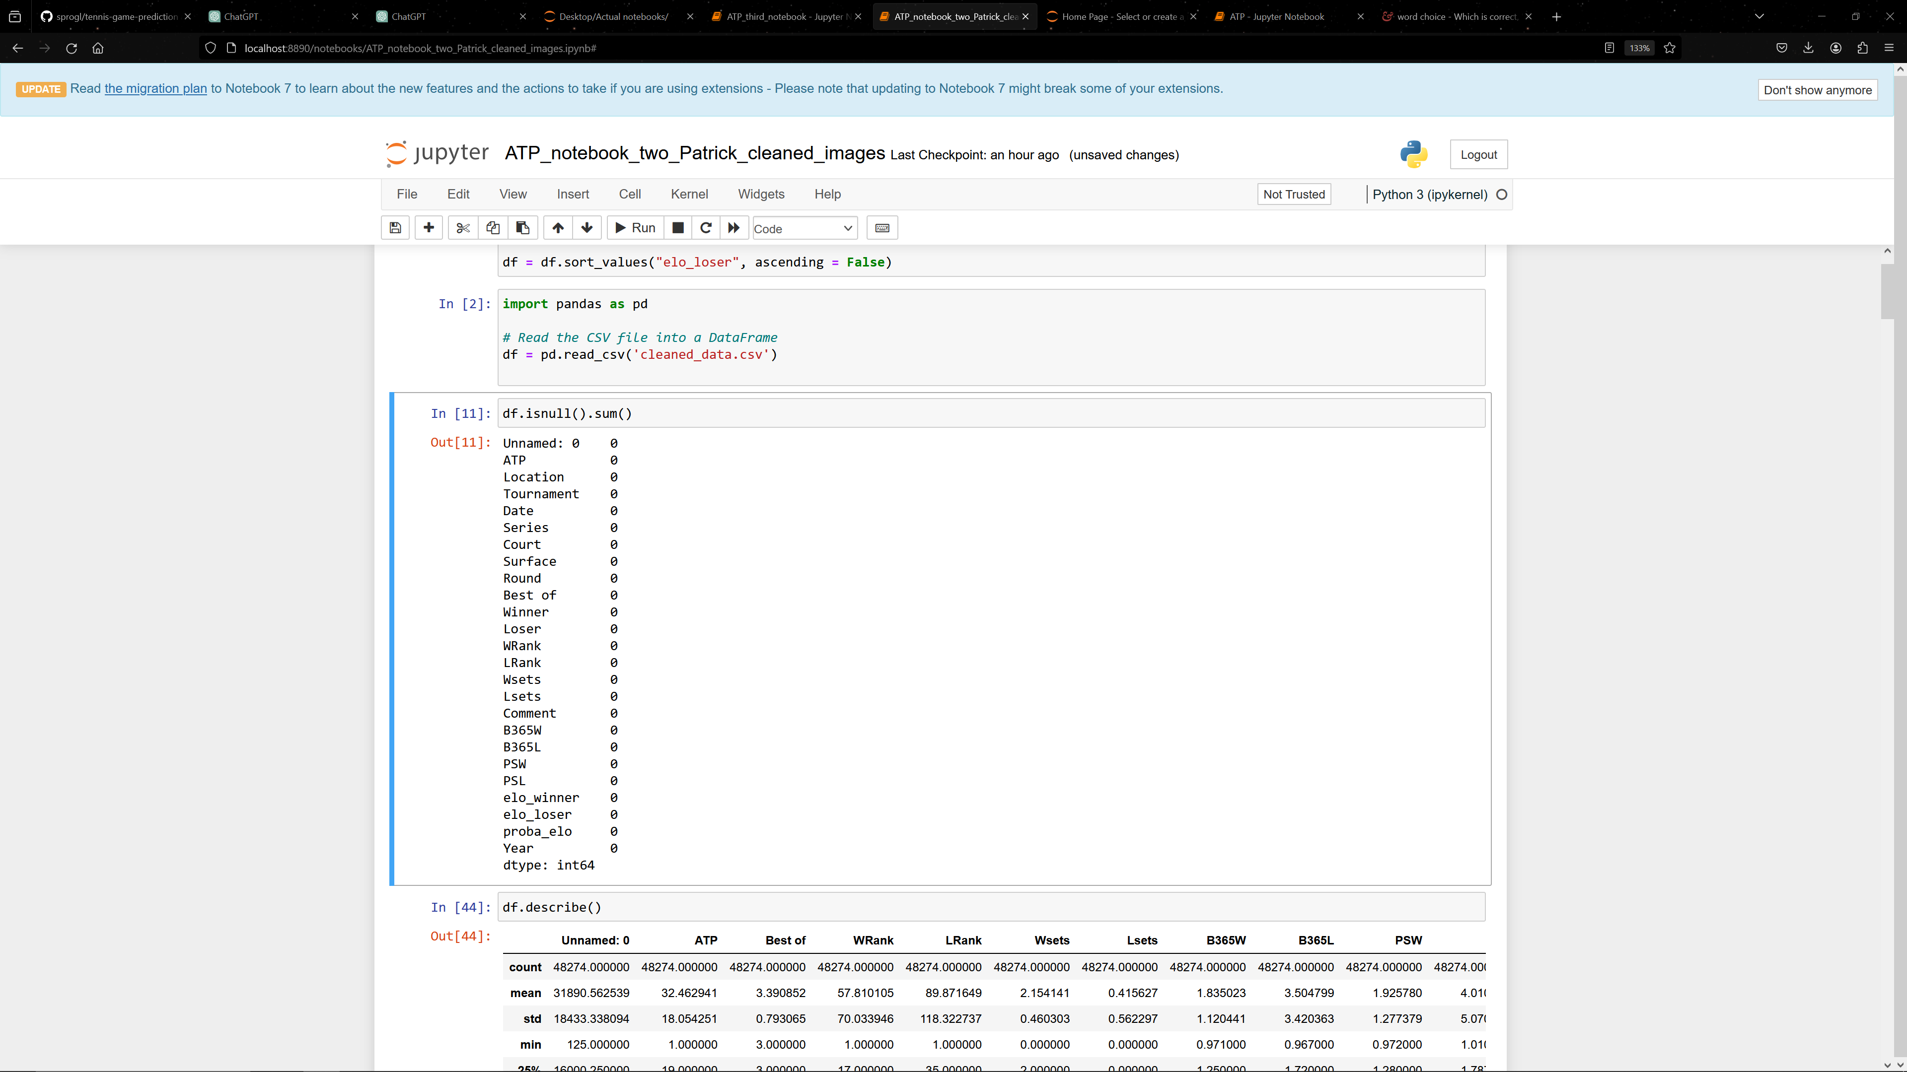
Cleaned Data set
The data frame has no missing values.

Slide 6
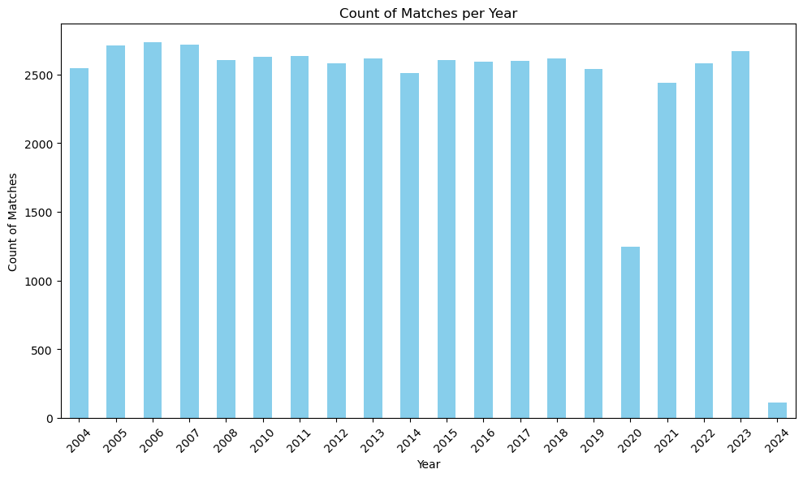
Exploration of the data set
The cleaned data frame has values from 2004 till January 2024!
Number of unique players: 1260

Slide 7
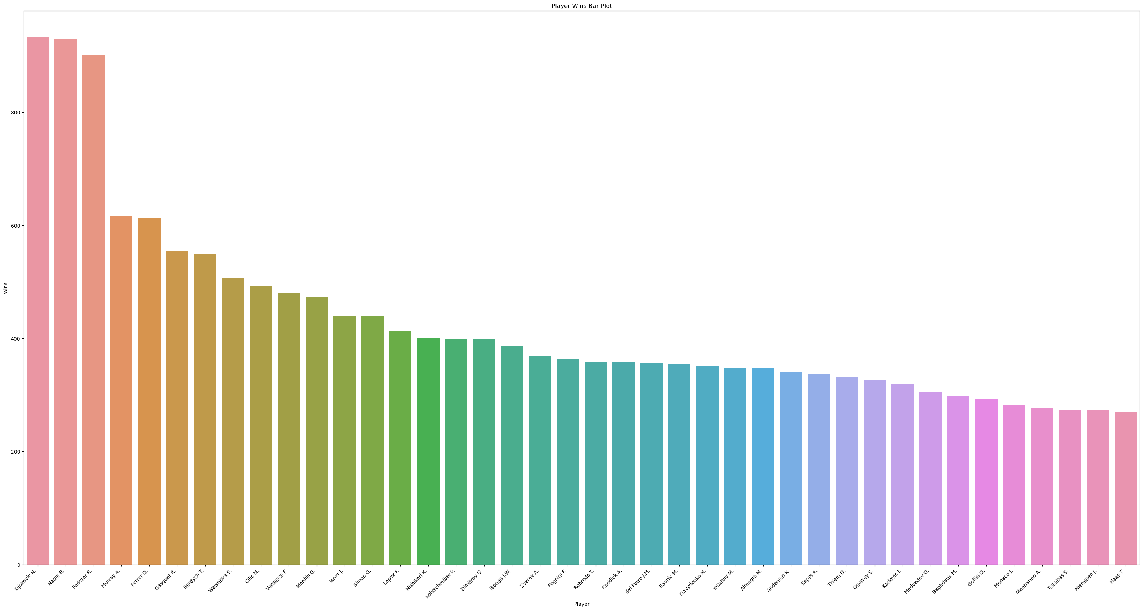
Who has won the most Matches?
Djokovic has won the most tennis matches during that time periode

Slide 8
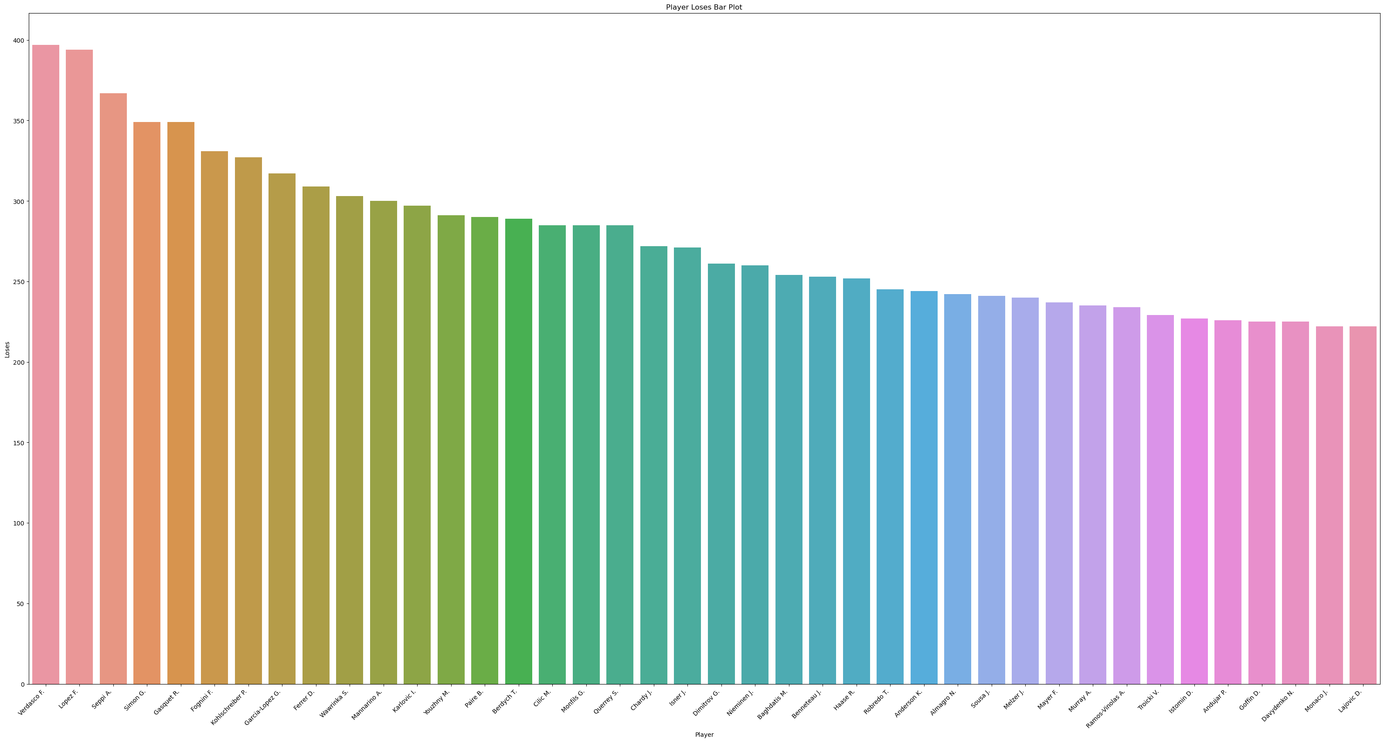
Who has lost the most matches
Verdasco has lost the most tennis matches

Slide 9
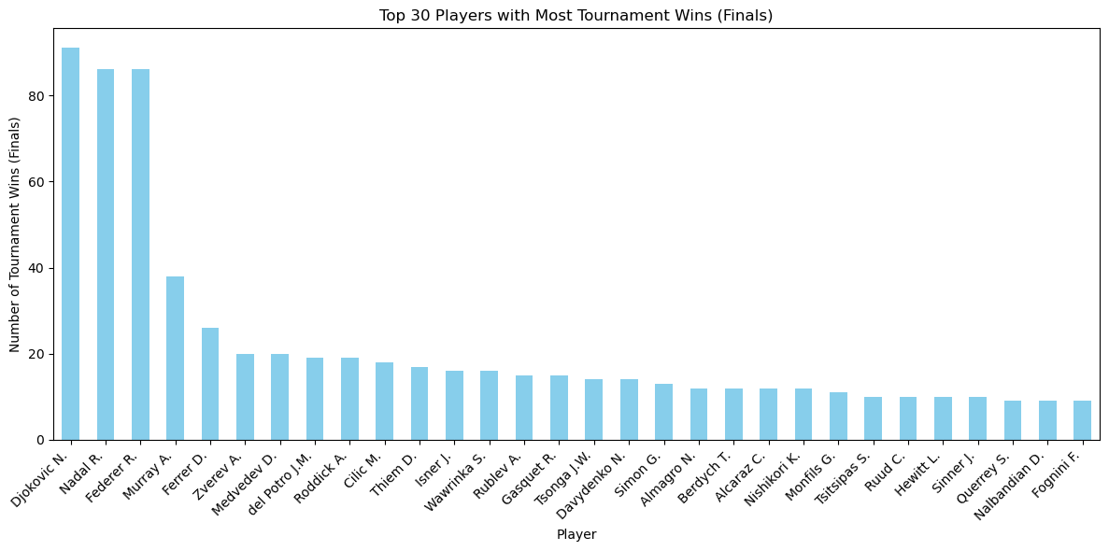
Which player has won the most tournaments

Slide 10
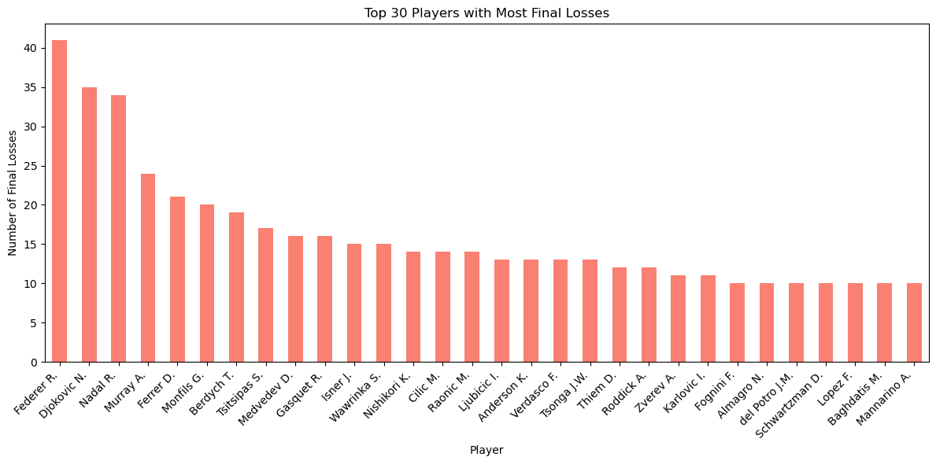
Which player has lost the most finals

Slide 11
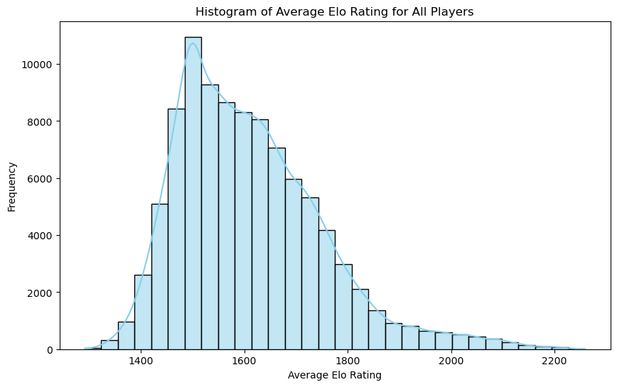
Elo Rating System
Mean of the average Elo ratings of all players: 1611

Slide 12
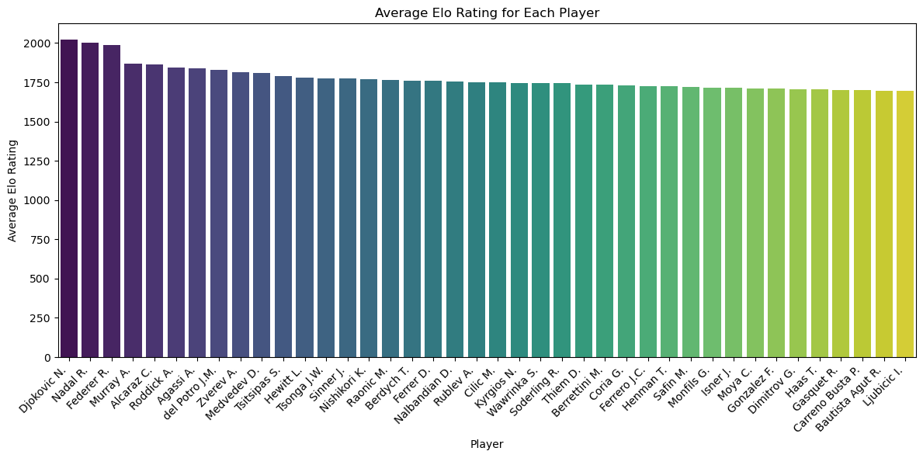
Which player has the best average Elo Rating
The best player on the ATP tour is Djokovic

Slide 13
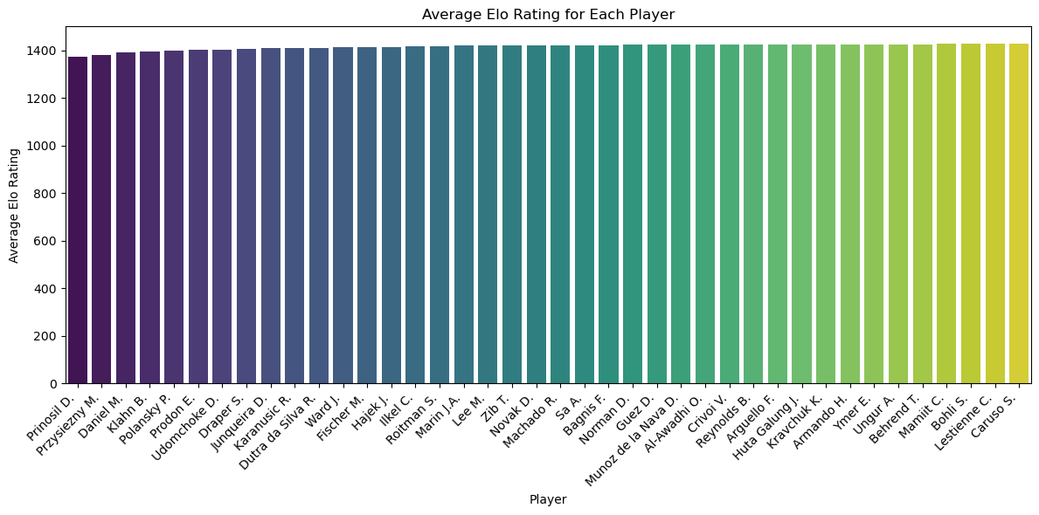
Who has the lowest Elo Rating
Prinosil has the lowest Elo Rating of all players

Slide 14
Which betting house has the better odds?

Slide 15
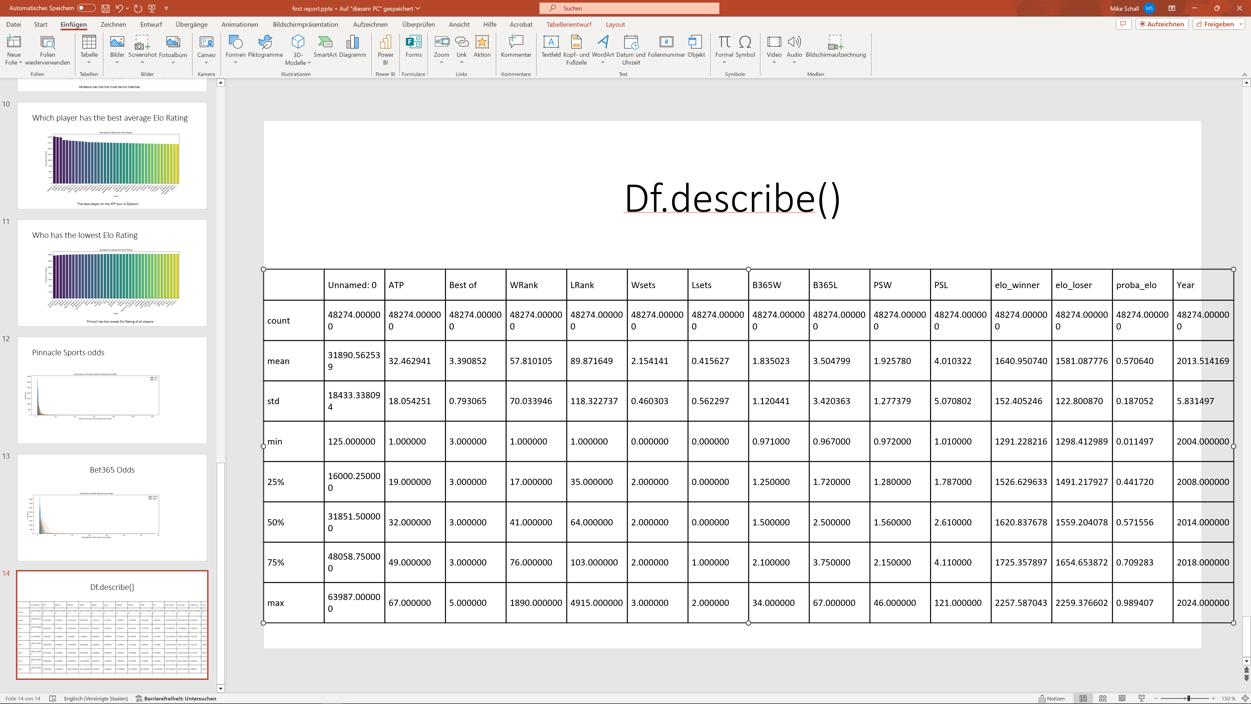
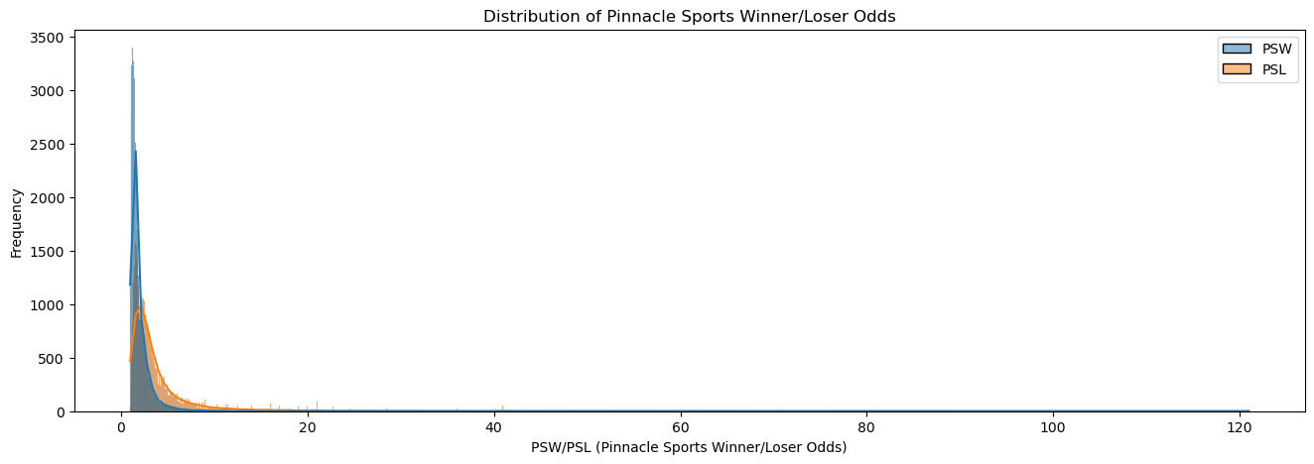
Pinnacle Sports odds

Slide 16
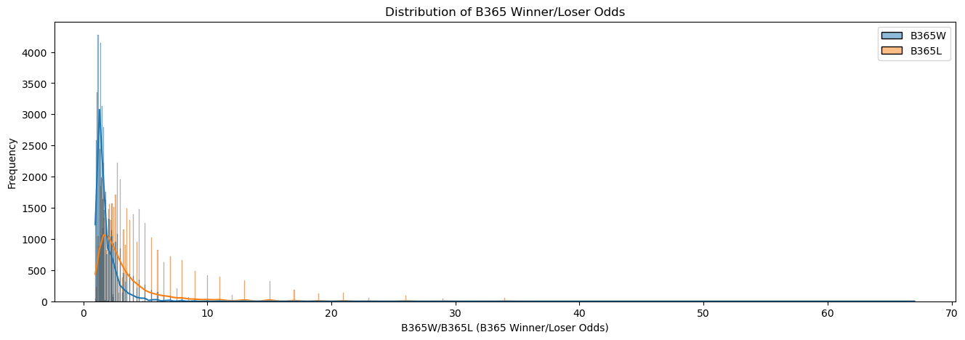
Bet365 Odds

Slide 17
Which betting house has the better odds?
On average the bedder odds has Pinnacle Sports odds

Slide 18
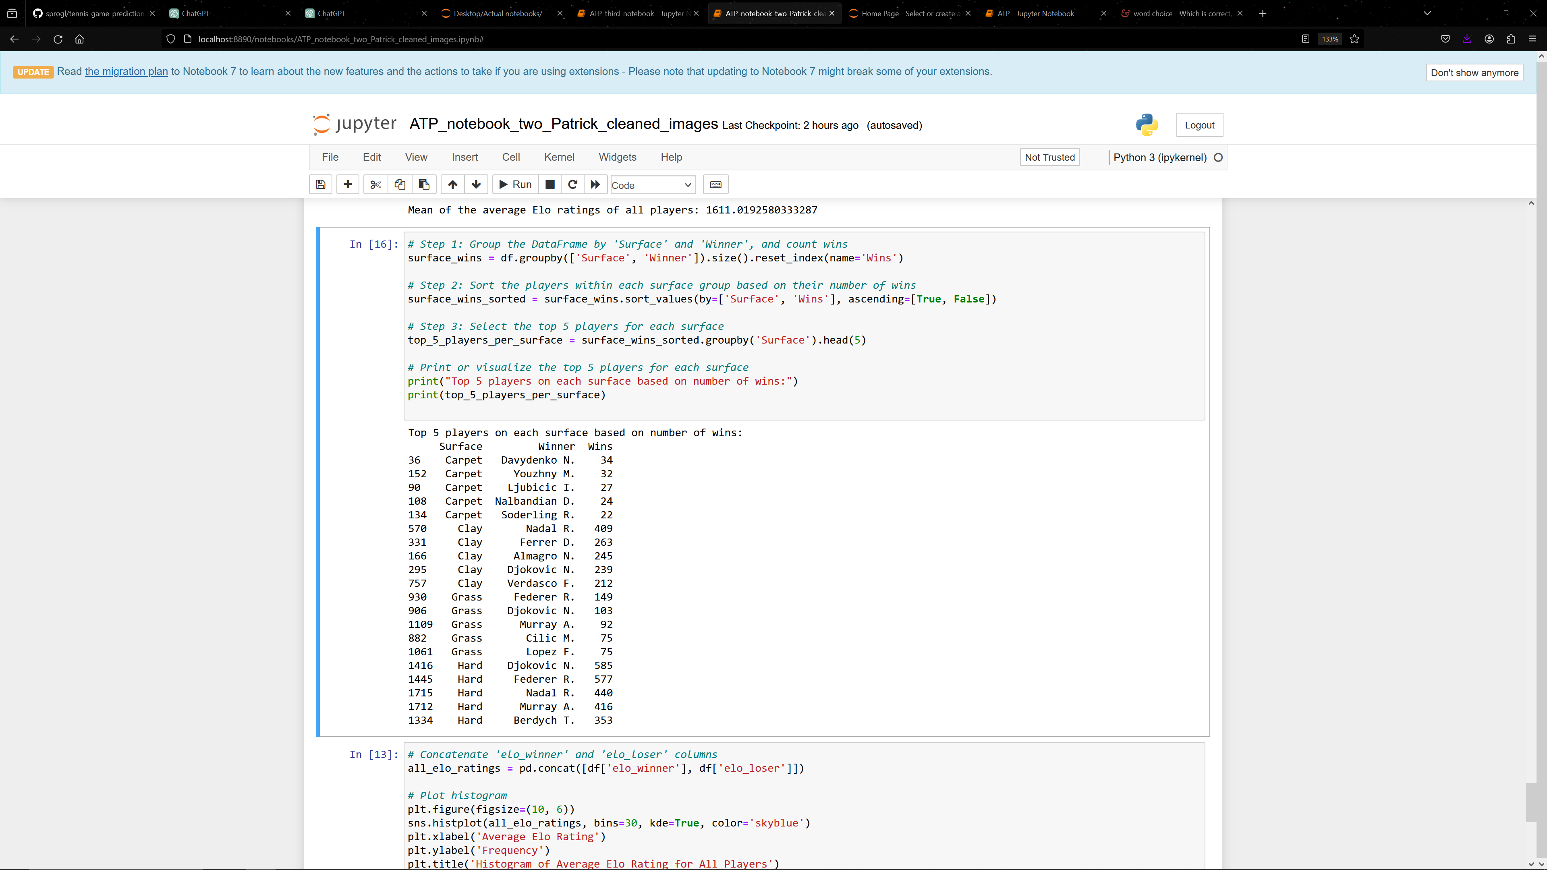
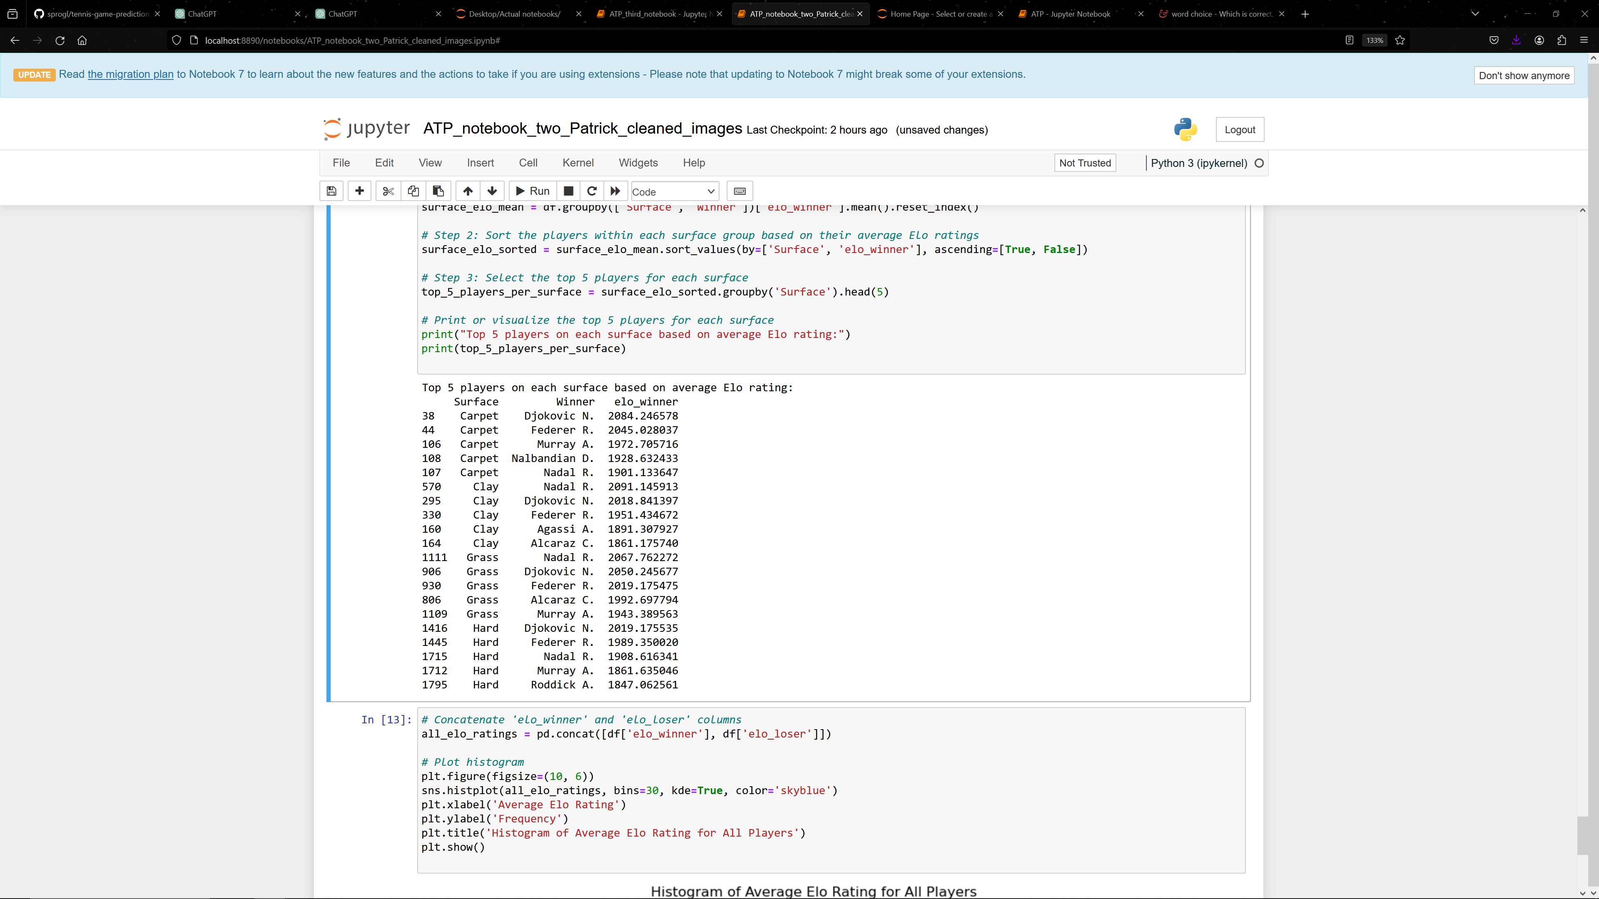
Does the surface matters

Slide 19
Objectives of this research
Predict who is going to win/lose the next game
How many sets will be played in a game and how many sets will be won by each player
Who is the shooting star?
Which player will gain the most elo in the next season?
Which player will player will stagnate in the next season
Who will win the most tournaments
Who will be the number one in world ranking next season.
Predict, when a low rated player is likely to beat are higher rated player
(low elo_proba value)

Slide 20
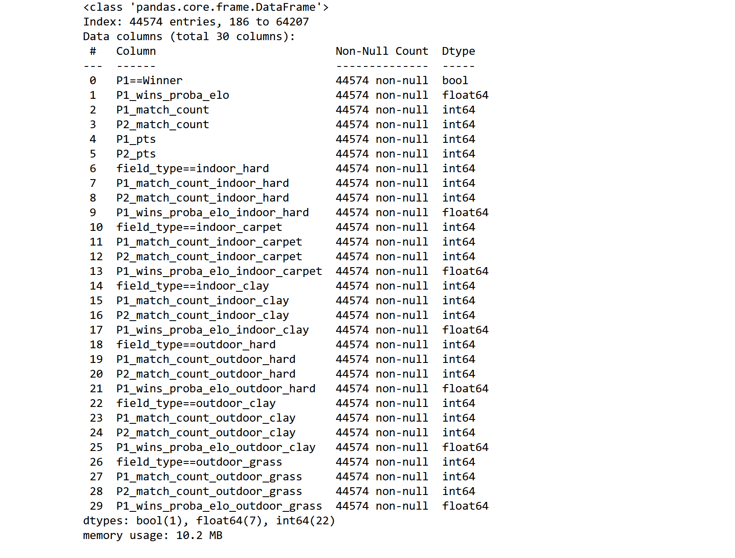
Data frame for modeling

Slide 21
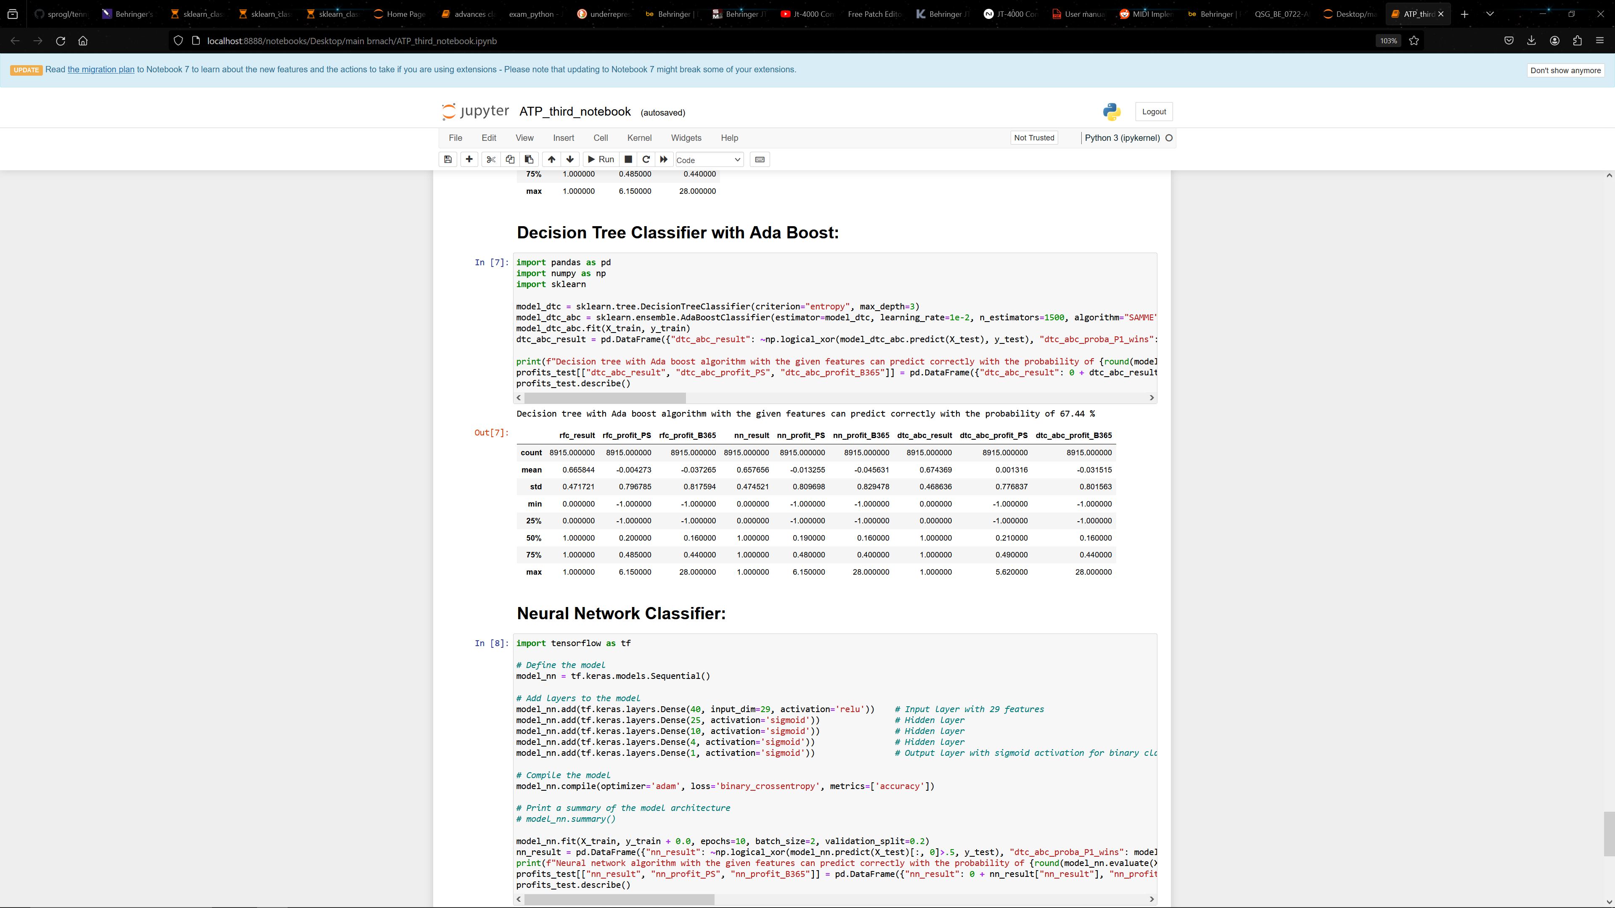
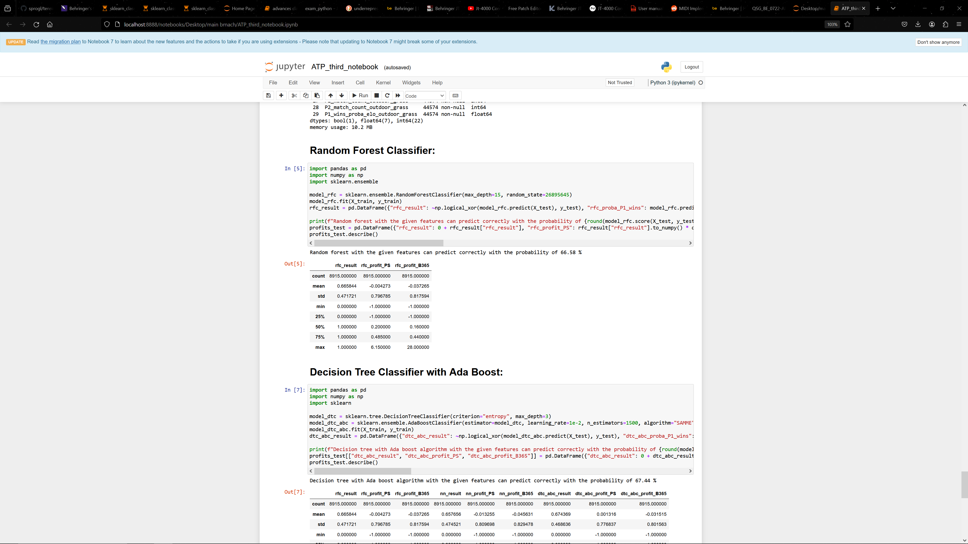
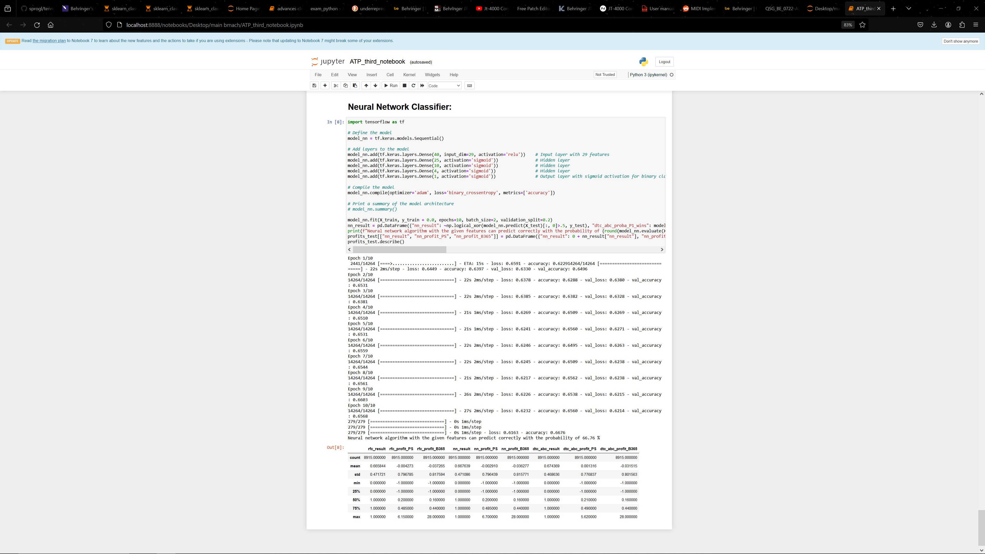

Slide 22
Addional data

Slide 23
Df.describe()
 | Unnamed: 0 | ATP | Best of | WRank | LRank | Wsets | Lsets | B365W | B365L | PSW | PSL | elo_winner | elo_loser | proba_elo | Year
count | 48274.000000 | 48274.000000 | 48274.000000 | 48274.000000 | 48274.000000 | 48274.000000 | 48274.000000 | 48274.000000 | 48274.000000 | 48274.000000 | 48274.000000 | 48274.000000 | 48274.000000 | 48274.000000 | 48274.000000
mean | 31890.562539 | 32.462941 | 3.390852 | 57.810105 | 89.871649 | 2.154141 | 0.415627 | 1.835023 | 3.504799 | 1.925780 | 4.010322 | 1640.950740 | 1581.087776 | 0.570640 | 2013.514169
std | 18433.338094 | 18.054251 | 0.793065 | 70.033946 | 118.322737 | 0.460303 | 0.562297 | 1.120441 | 3.420363 | 1.277379 | 5.070802 | 152.405246 | 122.800870 | 0.187052 | 5.831497
min | 125.000000 | 1.000000 | 3.000000 | 1.000000 | 1.000000 | 0.000000 | 0.000000 | 0.971000 | 0.967000 | 0.972000 | 1.010000 | 1291.228216 | 1298.412989 | 0.011497 | 2004.000000
25% | 16000.250000 | 19.000000 | 3.000000 | 17.000000 | 35.000000 | 2.000000 | 0.000000 | 1.250000 | 1.720000 | 1.280000 | 1.787000 | 1526.629633 | 1491.217927 | 0.441720 | 2008.000000
50% | 31851.500000 | 32.000000 | 3.000000 | 41.000000 | 64.000000 | 2.000000 | 0.000000 | 1.500000 | 2.500000 | 1.560000 | 2.610000 | 1620.837678 | 1559.204078 | 0.571556 | 2014.000000
75% | 48058.750000 | 49.000000 | 3.000000 | 76.000000 | 103.000000 | 2.000000 | 1.000000 | 2.100000 | 3.750000 | 2.150000 | 4.110000 | 1725.357897 | 1654.653872 | 0.709283 | 2018.000000
max | 63987.000000 | 67.000000 | 5.000000 | 1890.000000 | 4915.000000 | 3.000000 | 2.000000 | 34.000000 | 67.000000 | 46.000000 | 121.000000 | 2257.587043 | 2259.376602 | 0.989407 | 2024.000000

